Slide 1
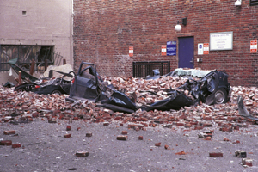
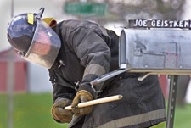
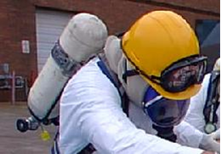
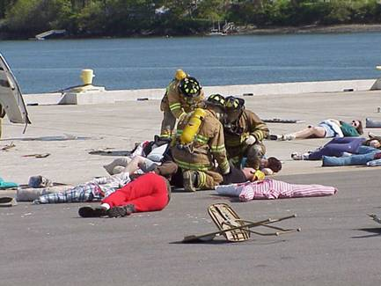
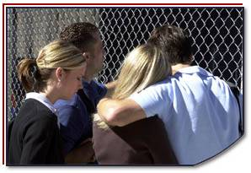
Disaster Site Worker Safety
Decontamination

Slide 2
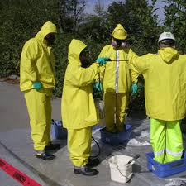
Introduction
Safety of all site workers is of paramount importance.
Disaster Sites are often contaminated with residues of various chemicals, fuels, and biologic’s.
A Decontamination Plan and Established Decontamination Line for workers shall be established before work begins.

Slide 3
Introduction
First step in decontamination is to explain the procedures that will minimize contact with waste and thus the potential for contamination.
For example:
Stress work practices that minimize contact with hazardous substances (e.g., do not walk through areas of obvious contamination, do not directly touch potentially hazardous substances).
Be aware of containers, compressed gas bottles and fuel storage tanks that may have been dislodged shifted or floated to other areas than their original platforms of storage areas. The vessels and containers may be leaking.

Slide 4
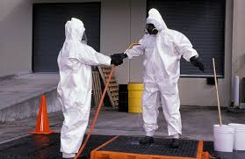
Objective
Upon completion of this module, participants will understand the purpose and process of decontamination.

Slide 5
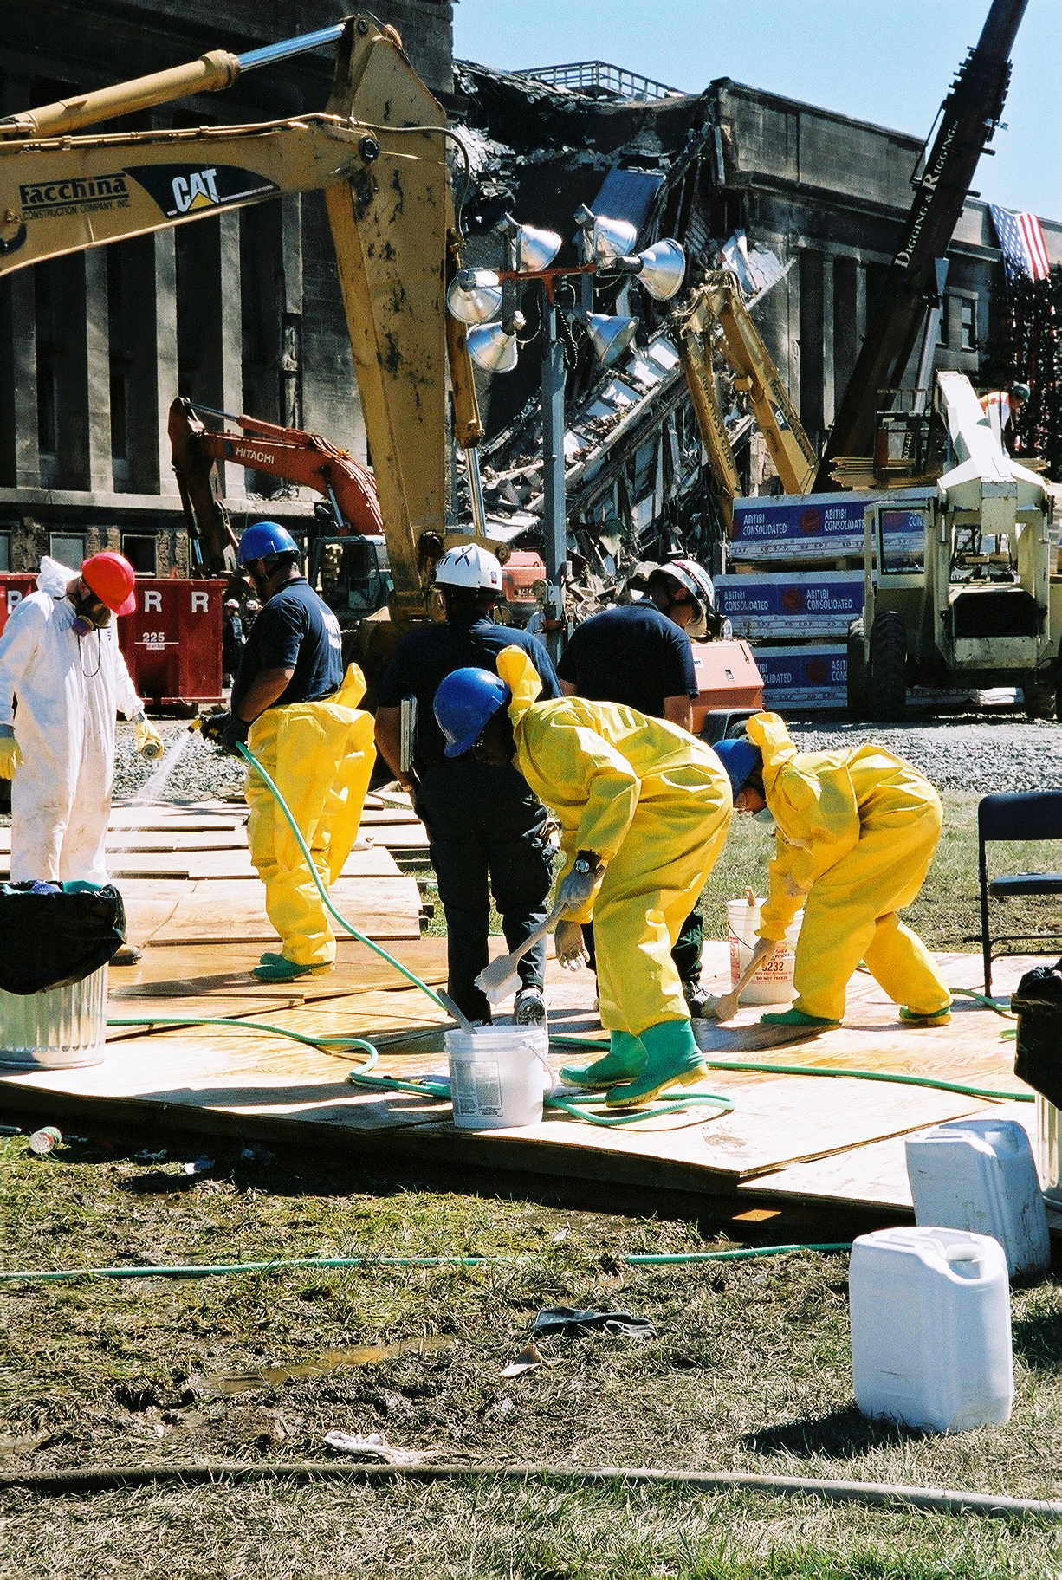
Objectives
Describe the decontamination procedures.
Identify the purposes and effects of decontamination.
Perform proper self-decontamination.
Identify steps taken to enhance safety of all personnel while conducting decontamination.

Slide 6
Decontamination Issues
Field decontamination
Victim transportation
Hospital decontamination facilities
Decontamination at mass care facilities
Contaminated clothing and equipment disposal
Disposition of the deceased
Environmental decontamination

Slide 7
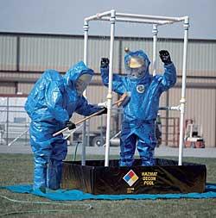
Decontamination
Decontamination plan should:
Determine the number and layout of decontamination stations.
Determine the type of decontamination equipment needed.
Determine appropriate decontamination methods.
Establish procedures to prevent contamination of clean areas.

Slide 8
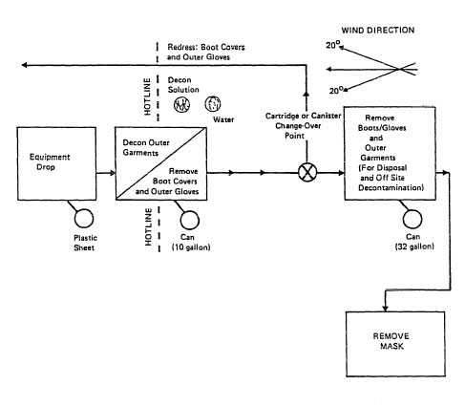
Decontamination
Decontamination layout plan
https://www.osha.gov/SLTC/hazardouswaste/training/decon.html

Slide 9
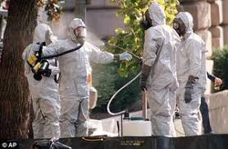
Decontamination Considerations
Weather
Wind Direction/Topography
Site assessment of what contaminants are present on site
What size of Decontamination site is needed.
Disposal of waste water and PPE

Slide 10
Decontamination Equipment
Basic equipment for site worker decontamination should include, ground tarps, kiddie pools, buckets and brushes, hoses or water sprayers, soap, bleach, trash bags and trash receptacles to discard outer wear PPE.
Shower facilities although sometimes difficult within the disaster site area should be established or made available as decontamination of the body is also a priority during these site work hours as the contaminates will adhere to the skin and needs to be removed.

Slide 11
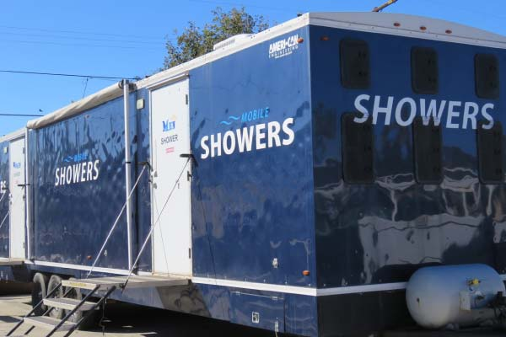
Decontamination support Equipment
Shower facilities
Should be established or made available.
Decontamination of the body is also a priority during these site work hours as the contaminates will adhere to the skin and needs to be removed.

Slide 12
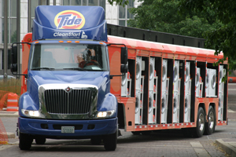
Decontamination support equipment
Laundry facilities
Should be established or made available.
Clothing is also a priority during these site work hours as the contaminates may adhere to clothing.
Clothing needs to be cleaned to remove contaminants.

Slide 13
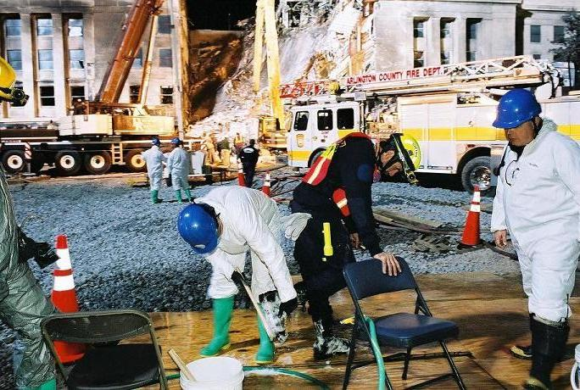
Decontamination
Workers should take special care when working around contaminants to insure that their PPE has not been permeated or compromised.
Level C and D PPE only provide minimal protection against contaminants.
Check the manufacturer’s guidelines on the permeation timelines of their products (i.e. Tyvek suits, gloves, boots).

Slide 14
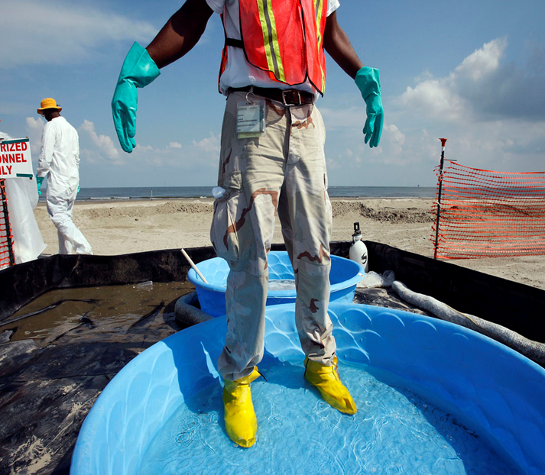
Purpose for Decontamination
Three most important reasons for decontaminating exposed workers are:
To remove containments from the workers personnel protective equipment and the workers themselves.
To protect workers from secondary transfer exposures.
To provide worker with psychological comfort.

Slide 15
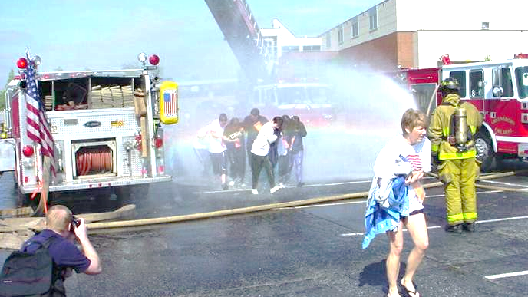
Types of Decontamination
There are two type of decontaminating procedures to protect exposed workers:
Gross
Technical

Slide 16
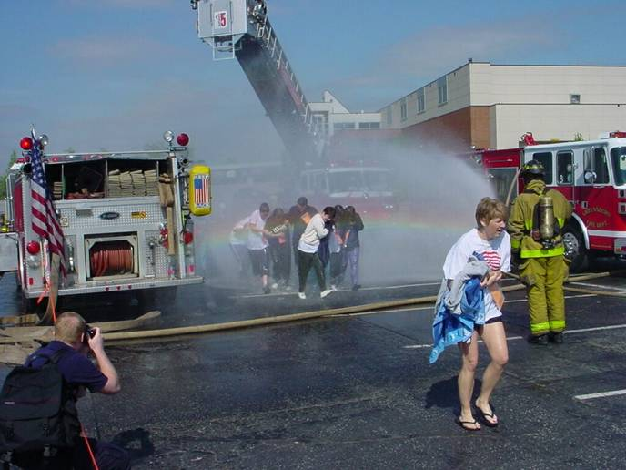
Gross Decontamination
Gross Decontamination
Which is used for emergencies where an established technical decontamination station has not been established. These types of decontamination procedures are conducted by emergency responders usually the fire department.

Slide 17
Technical Decontamination
Technical Decontamination Line
It is not time constrained.
It is a thorough detailed plan.
Determine the number and layout of decontamination stations.
Determine the equipment needed.
Determine appropriate methods.
Establish procedures to prevent contamination of clean areas.

Slide 18
Technical Decontamination
Establish methods & procedures to minimize worker contact with contaminants during removal of PPE.
Establish methods for disposing of clothing and equipment that are not completely decontaminated.

Slide 19
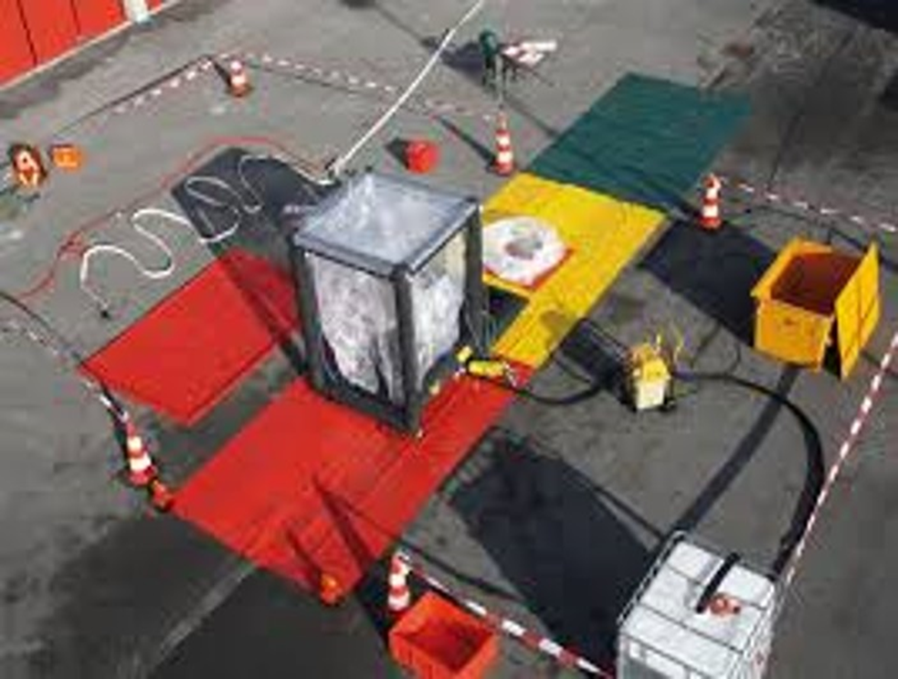
Establishing a Decontamination Corridor
No matter how large or small decontamination sites need to be established with a corridor of zoning.
Using standard hazardous material decontamination terminology the three zone system will be used to safely and effectively guide the worker through the decontamination process.
Notes:
The Red Zone will be the first in the line of decontamination where in this area the worker initially well soaped and then brush scrubbed, then well rinsed.
The Amber Zone will be a repeat of the red zone process with the understanding that at this stage the heavy contaminates should have previously been removed within the red zone area.
The Green Zone is the final rinse and inspection zone. At this zone site all contaminants should have been removed and a visual inspection should be preformed to insure there are no visual contaminants left on outer wear PPE.
Upon exiting the green zone all PPE outer wear will be properly discarded.

Slide 20
Establishing a Decontamination Corridor
RED Zone is the first station in decontamination:
Worker is initially well soaped
Brush scrubbed
Then well rinsed
RED

Slide 21
Establishing a Decontamination Corridor
AMBER Zone will be a repeat of the red zone process with the understanding that at this stage the heavy contaminates should have previously been removed within the red zone area.
RED
AMBER

Slide 22
Establishing a Decontamination Corridor
GREEN Zone is the final rinse and inspection zone.
At this zone site all contaminants should have been removed.
Visual inspection should be preformed to insure there are no visual contaminants left on outer wear PPE.
Upon exiting the green zone all PPE outer wear will be properly discarded.
RED
AMBER
GREEN

Slide 23
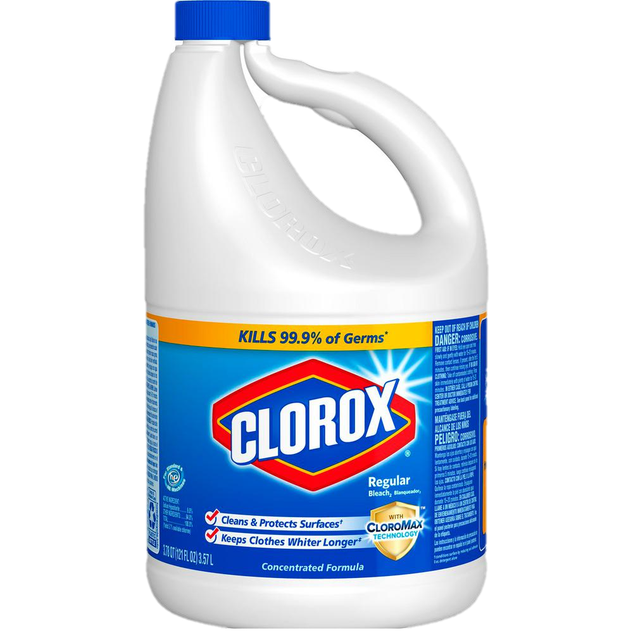
Removal of Contaminants
Decontaminants:
Water and a surfactant (Soap)
If a biologic is present include 0.5% bleach solution (hypochlorite)

Slide 24
Completion of the Decontamination Process
Once you have completed your decontamination process:
Exit to the clean area.
Designate a gathering point in the clean zone.
DO NOT RE-ENTER THE WORK SITE!
Notes:
Often site workers after being decontaminated turn right around and re-enter site to observe to re-group with coworkers.

Slide 25
Decontamination review
What are the three most important reasons for decontaminating an exposed worker?
To remove the containments from the workers personnel protective equipment and the workers themselves.
To protect workers from secondary transfer exposures.
To provide the worker with psychological comfort.

Slide 26
Decontamination review
Test your knowledge
With the pictures given, identify the two types of DECONTAMINATION?
GROSS
TECHNICAL

Slide 27
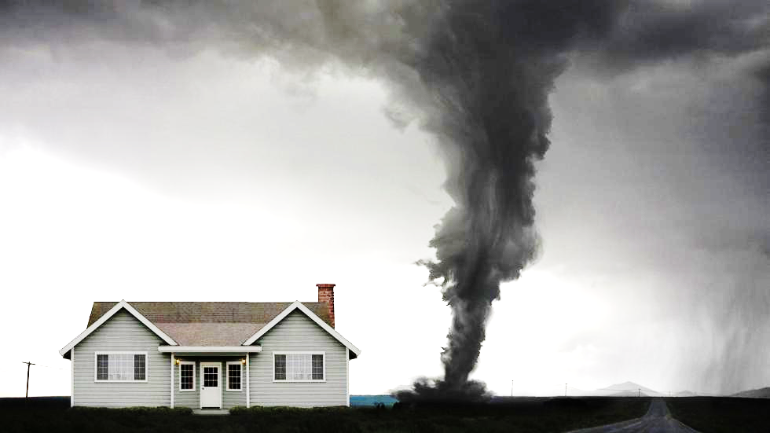
Dashboard
ICS

